Slide 1
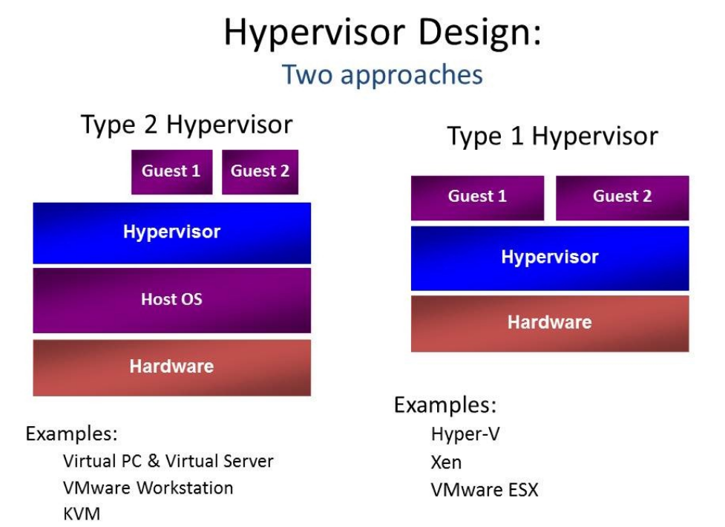

Slide 2
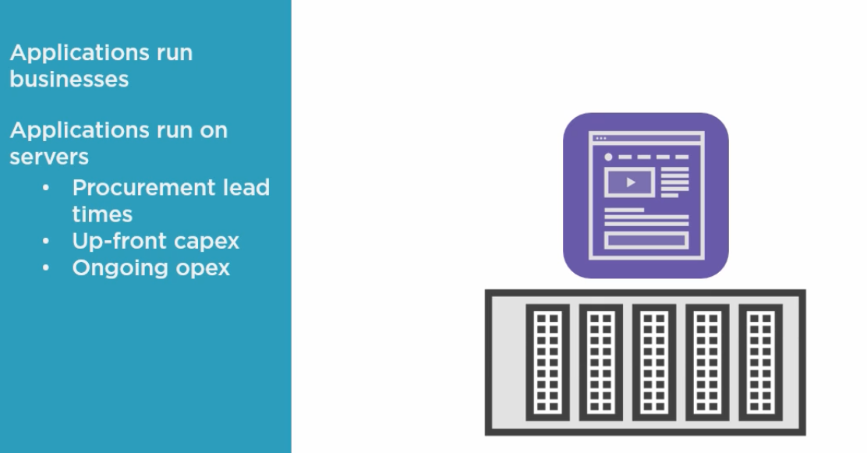

Slide 3
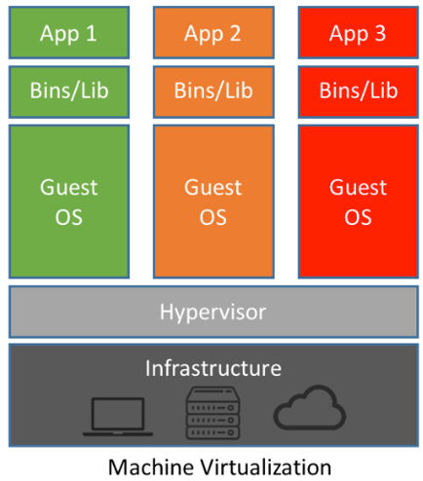

Slide 4
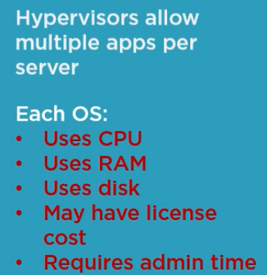

Slide 5
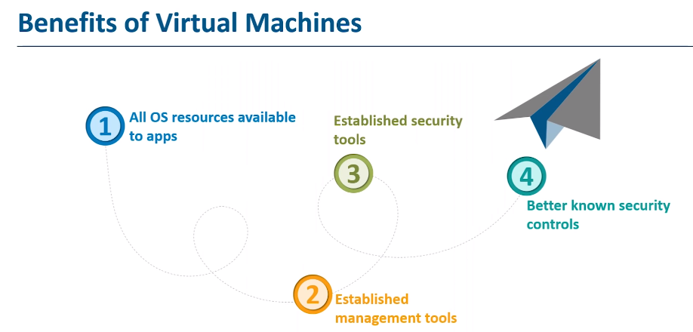

Slide 6
What is Docker ?
A Docker container image is a lightweight, standalone, executable package of software that includes everything needed to run an application: code, runtime, system tools, system libraries and settings.
Container images become containers at runtime and in the case of Docker containers - images become containers when they run on Docker Engine
Available for both Linux and Windows-based applications, containerized software will always run the same, regardless of the infrastructure. Containers isolate software from its environment and ensure that it works uniformly despite differences for instance between development and staging.

Slide 7
Containers
Containers are an abstraction at the app layer that packages code and dependencies together. Multiple containers can run on the same machine and share the OS kernel with other containers, each running as isolated processes in user space. Containers take up less space than VMs (container images are typically tens of MBs in size), can handle more applications and require fewer VMs and Operating systems.

Slide 8
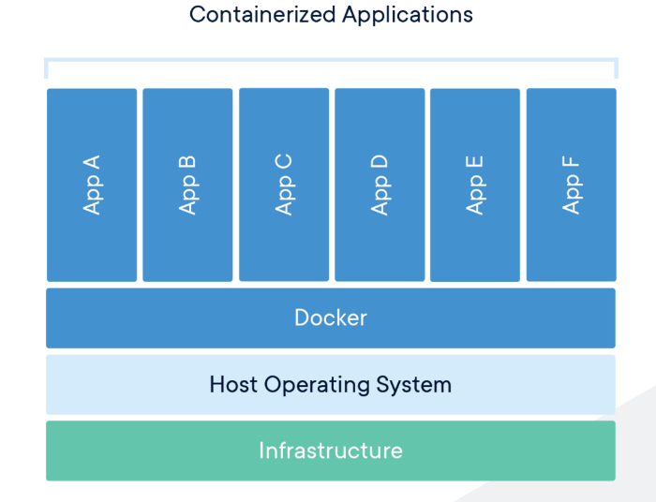

Slide 9
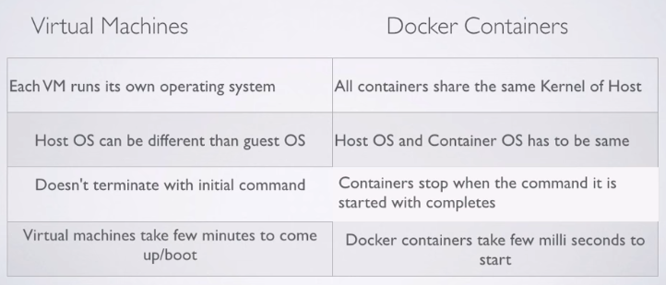

Slide 10
Advantages for the Development Team
Full control over the execution environment of the application. This includes the necessary infrastructure like the JRE, the application server, VM arguments and other environment variables the application needs to run. The infrastructure can be changed easily and independently by the development team, because they don’t have to wait for the operations team to change the environment

Slide 11
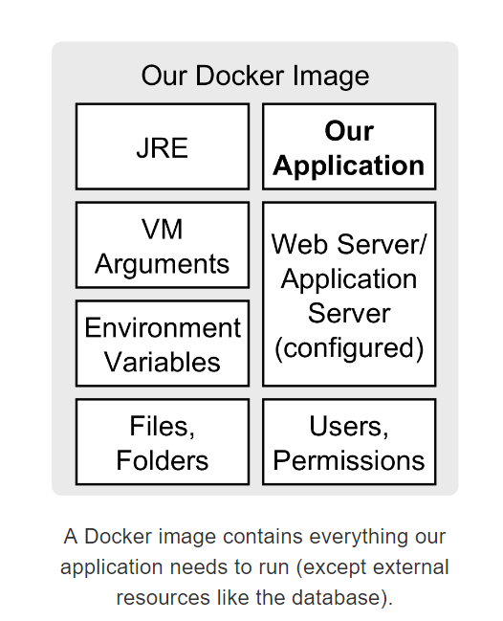

Slide 12
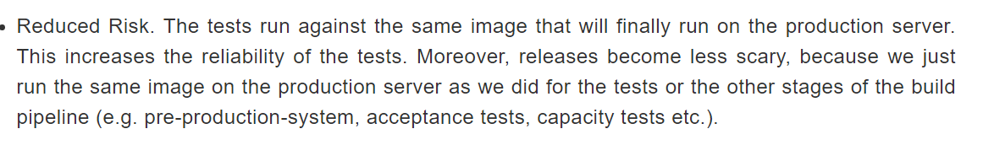

Slide 13
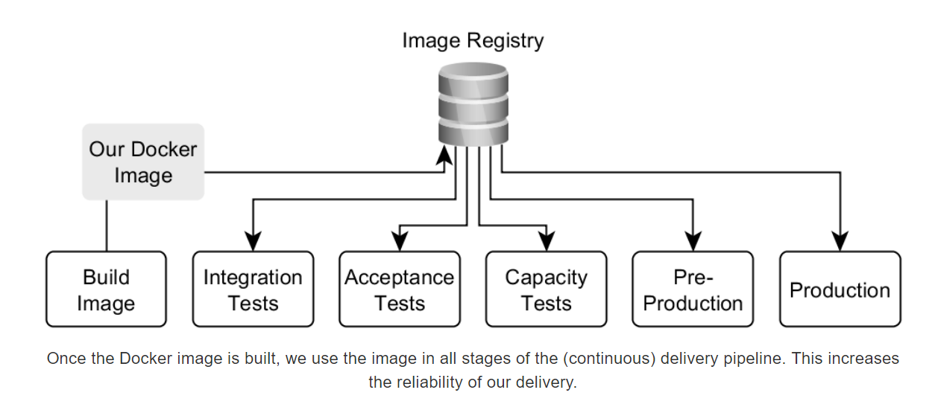

Slide 14
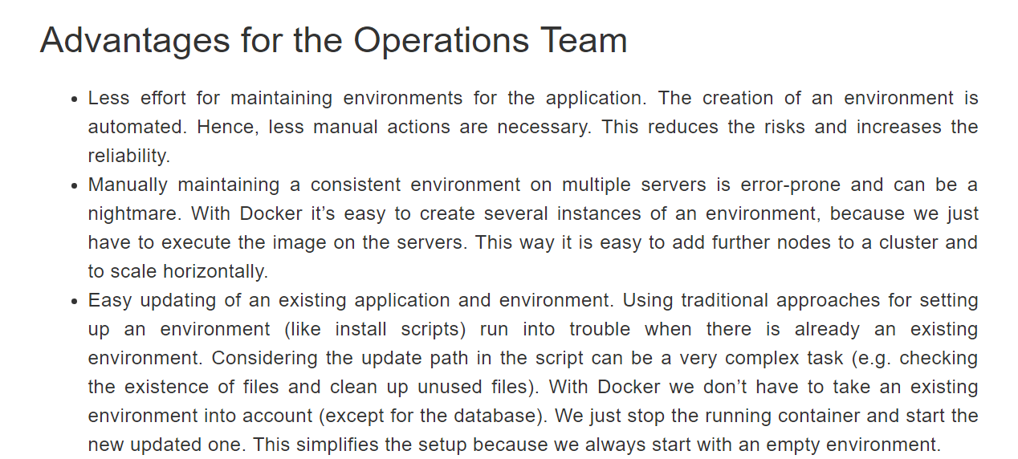

Slide 15
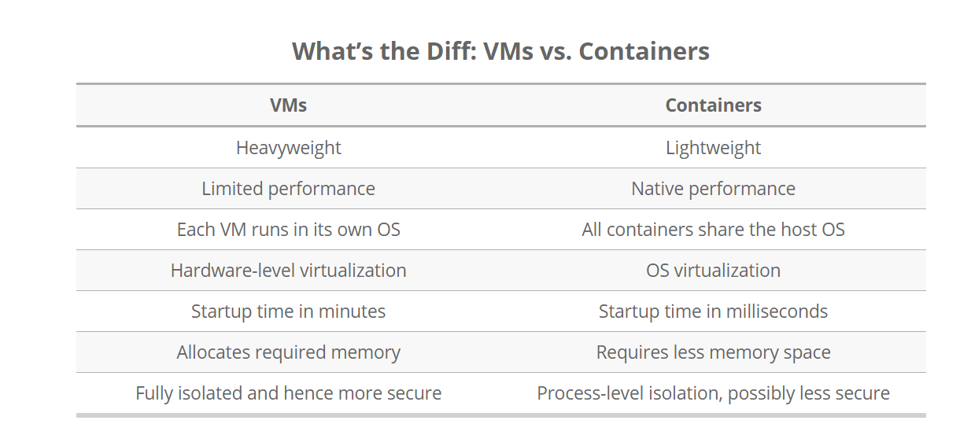

Slide 16
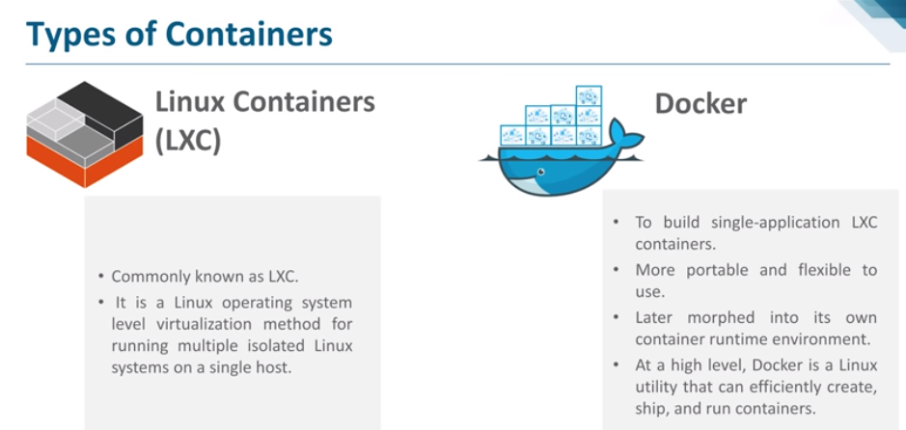

Slide 17
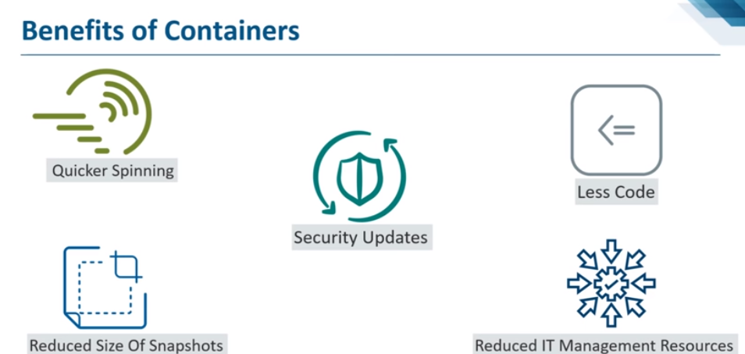

Slide 18
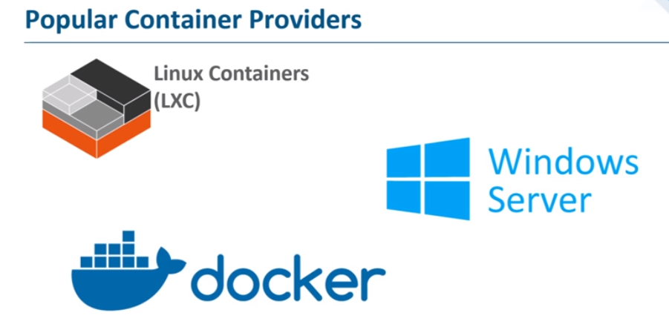

Slide 19
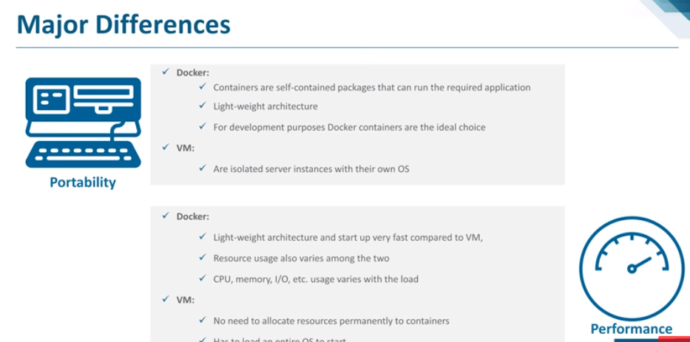

Slide 20
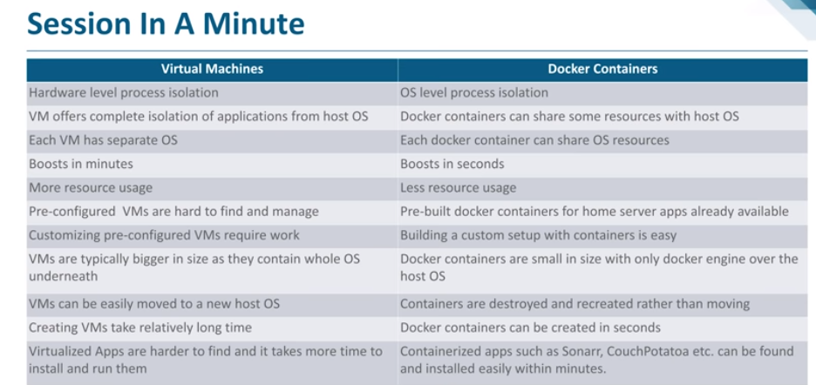

Slide 21
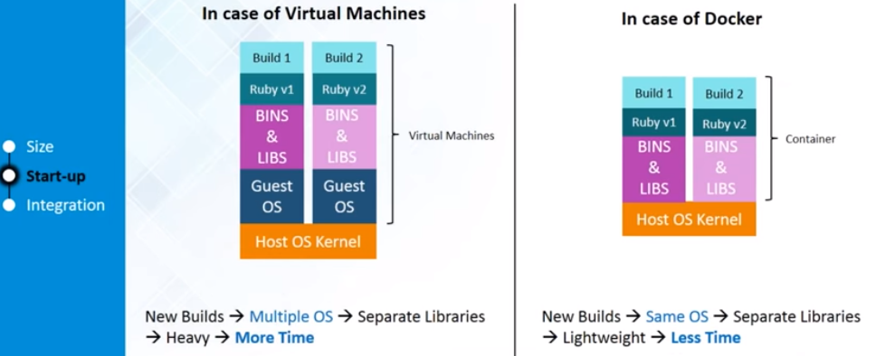

Slide 22
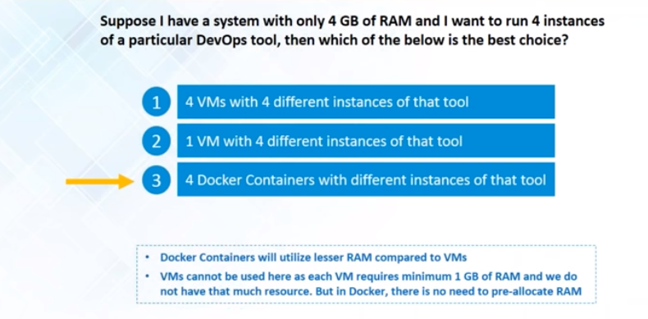

Slide 23
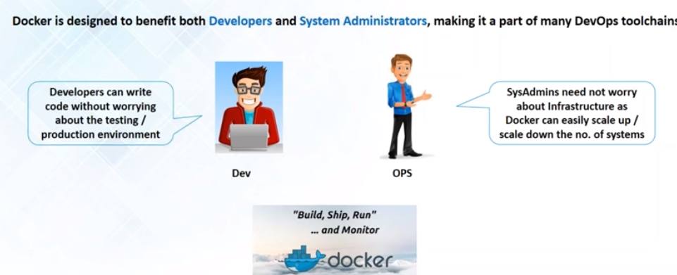

Slide 24
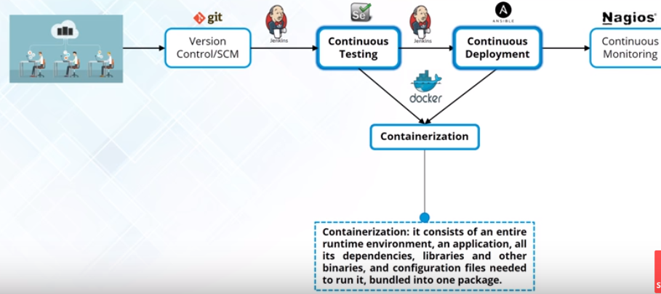
How is Docker used in Devops?

Slide 25
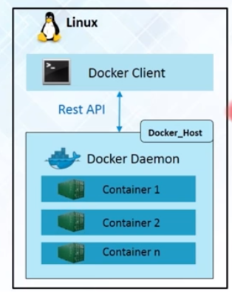
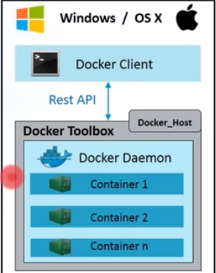
Docker Engine

Slide 26
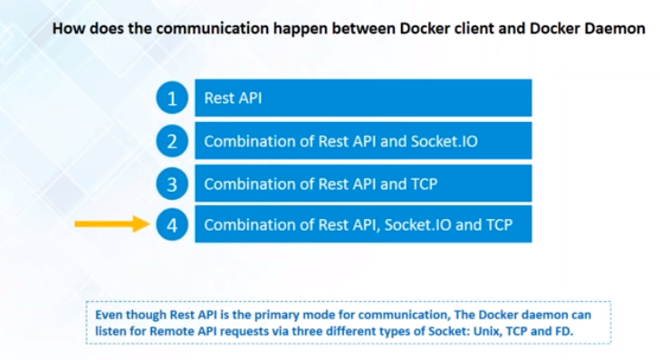

Slide 27
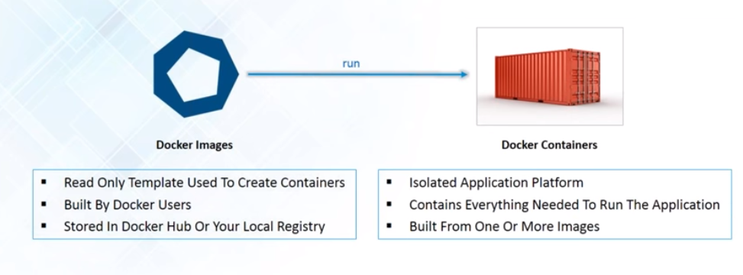
Docker Images and Containers

Slide 28
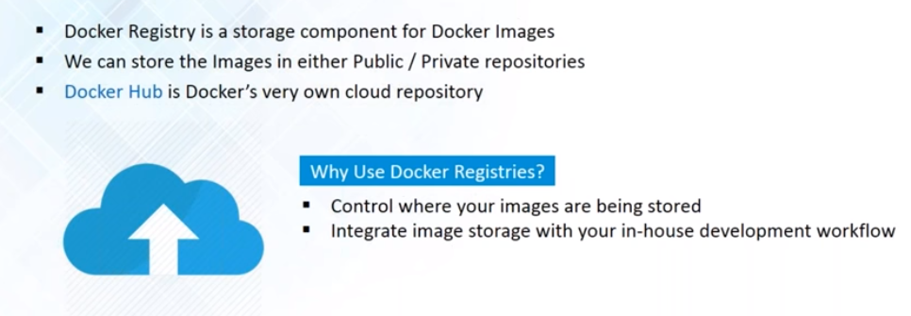
Docker Registry

Slide 29
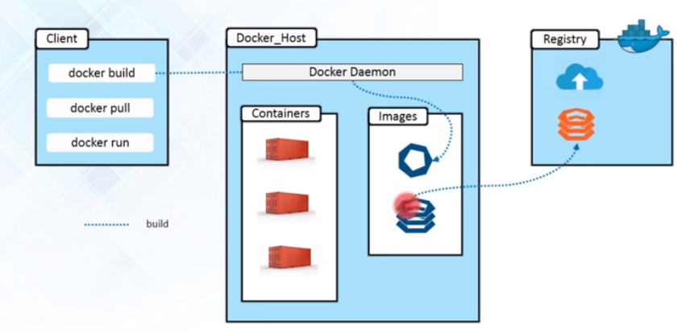

Slide 30
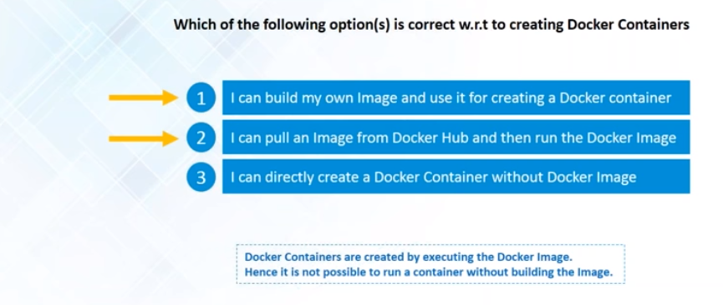

Slide 31
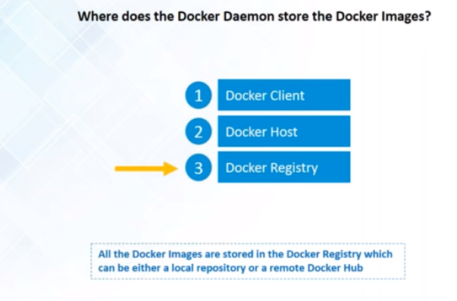

Slide 32
Amazon ECS
Amazon Elastic Container Service (ECS) is a highly scalable, high performance container management service that supports Docker containers and allows you to easily run applications on a managed cluster of Amazon EC2 instances. Amazon ECS eliminates the need for you to install, operate, and scale your own cluster management infrastructure. With simple API calls, you can launch and stop container-enabled applications, query the complete state of your cluster, and access many familiar features like security groups, Elastic Load Balancing, EBS volumes and IAM roles. You can use Amazon ECS to schedule the placement of containers across your cluster based on your resource needs and availability requirements. You can also integrate your own scheduler or third-party schedulers to meet business or application specific requirements.

